Slide 1


UNIVERSITY INSTITUTE OF ENGINEERING
COMPUTER SCIENCE & ENGINEERING
Introduction to Information Security and Cryptography
(Subject Code:20CST-354/ITT-354)
Prepared By : Er. Puneet kaur(E6913)
INTRODUCTION
DISCOVER . LEARN . EMPOWER

Slide 2

Digital Signatures
www. cuchd.in Campus : Gharaun, Mohali

Slide 3
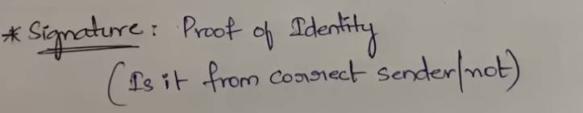

Slide 4
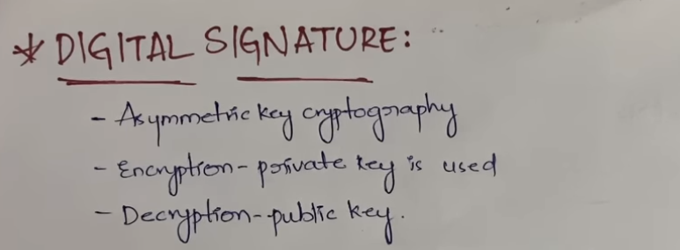

Slide 5
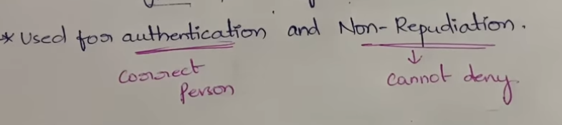

Slide 6
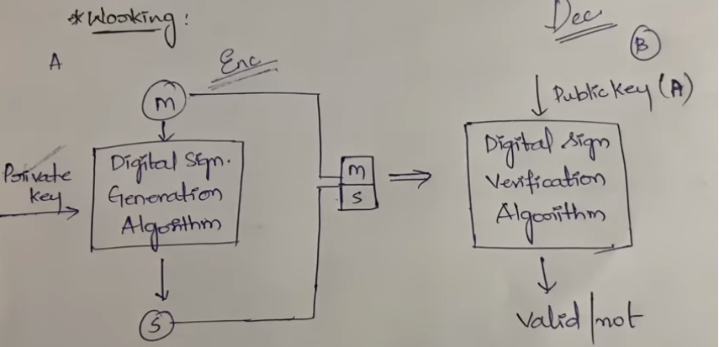

Slide 7



Slide 8
Why Digital Signatures?
Message authentication protects two parties who exchange messages from any third party.
However, it does not protect the two parties against each other.
Several forms of dispute between the two are possible.

Slide 9
Why Digital Signatures?
Example-1 : John sends an authenticated message to Mary.
Here two disputes may arise:
Mary may forge a different message and claim that it came from John. Mary would create a message and append an authentication code using the key that John and Mary share.
2. John can deny sending the message. Because it is possible for Mary to forge a message, there is no way to prove that John did in fact send the message.

Slide 10
Why Digital Signatures?
Example-2
An electronic funds transfer takes place, and the receiver increases the amount of funds transferred and claims that the larger amount had arrived from the sender.
Example-3
An electronic mail message contains instructions to a stockbroker for a transaction that subsequently turns out badly. The sender pretends that the message was never sent.

Slide 11
Why Digital Signatures?
In situations where there is not complete trust between sender and receiver, something more than authentication is needed.
The most attractive solution to this problem is the digital signature.

Slide 12
Why Digital Signatures?
Digital signature is an authentication mechanism that enables the creator of a message to attach a code that acts as a signature.
Typically the signature is formed by taking the hash of the message and encrypting the message with the creator’s private key.
The signature guarantees the source and integrity of the message.

Slide 13
Why Digital Signatures?
The digital signature standard (DSS) is a standard that uses the secure hash algorithm (SHA).
Most important development under public-key cryptography.

Slide 14
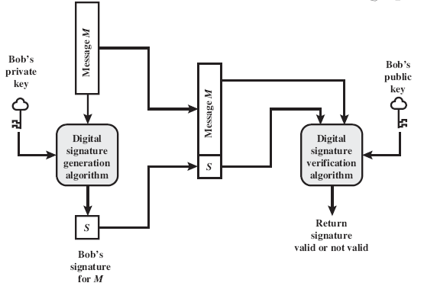
Generic Model of Digital Signature Process

Slide 15
Generic Model of Digital Signature Process
Bob can sign a message using a digital signature generation algorithm.
The inputs to the algorithm are the message and Bob’s private key.
Any other user, say Alice, can verify the signature using a verification algorithm, whose inputs are the message, the signature, and Bob’s public key.

Slide 16
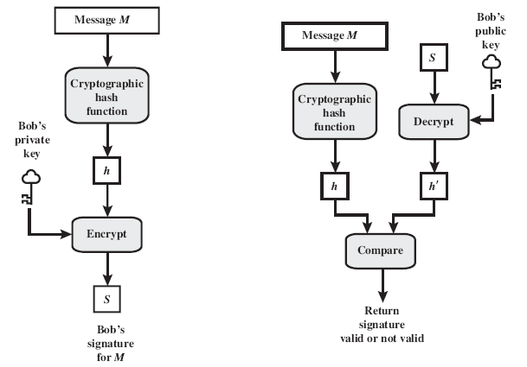
Elements of Digital Signature Process

Slide 17
Properties of Digital Signature
It must verify the author and the date and time of the signature.
It must authenticate the contents at the time of the signature.
It must be verifiable by third parties, to resolve disputes.
Thus, the digital signature function includes the authentication function.

Slide 18
Digital Signature Requirement
The signature must be a bit pattern that depends on the message being signed.
The signature must use some information unique to the sender to prevent both forgery and denial.
It must be relatively easy to produce the digital signature.
It must be relatively easy to recognize and verify the digital signature.

Slide 19
Digital Signature Requirement
It must be computationally infeasible to forge a digital signature, either by constructing a new message for an existing digital signature or by constructing a fraudulent digital signature for a given message.
It must be practical to retain a copy of the digital signature in storage.
Generic process and elements of digital signature fulfill these requirements.

Slide 20
Direct Digital Signature
The term direct digital signature refers to a digital signature scheme that involves only the communicating parties (source, destination).
It is assumed that the destination knows the public key of the source.
Generally Confidentiality can be provided by encrypting the entire message plus signature with a shared secret key (symmetric encryption)

Slide 21
Direct Digital Signature
It is important to perform the signature function first and then an outer confidentiality function. (Why?)
In case of dispute, some third party must view the message and its signature.
If the signature is calculated on an encrypted message, then the third party also needs access to the decryption key to read the original message.
However, if the signature is the inner operation, then the recipient can store the plaintext message and its signature for later use in dispute resolution.

Slide 22
Direct Digital Signature
The validity of this scheme depends on the security of the sender’s private key.
If a sender later wishes to deny sending a particular message, the sender can claim that the private key was lost or stolen and that someone else forged his or her signature.
Administrative controls relating to the security of private keys can be employed to thwart or at least weaken this ploy, but the threat is still there, at least to some degree.

Slide 23
Direct Digital Signature
The validity of this scheme depends on the security of the sender’s private key.
If a sender later wishes to deny sending a particular message, the sender can claim that the private key was lost or stolen and that someone else forged his or her signature.
Administrative controls relating to the security of private keys can be employed to thwart or at least weaken this ploy, but the threat is still there, at least to some degree.

Slide 24
Direct Digital Signature
Example : Every signed message to include a timestamp (date and time) and to require prompt reporting of compromised keys to a central authority.
Another threat is that some private key might actually be stolen from X at time T. The opponent can then send a message signed with X’s signature and stamped with a time before or equal to T.
The universally accepted technique for dealing with these threats is the use of a digital certificate and certificate authorities.

Slide 25
References
http://www.brainkart.com/article/Classical-Encryption-Techniques_8339/
https://www.tutorialspoint.com/cryptography/index.htm
https://www.geeksforgeeks.org/cryptography-introduction/
https://www.techopedia.com/definition/1770/cryptography#:~:text=Cryptography%20involves%20creating%20written%20or,information%20to%20be%20kept%20secret.&text=Information%20security%20uses%20cryptography%20on,transit%20and%20while%20being%20stored.
https://www2.slideshare.net/lineking/classical-encryption-techniques-in-network-security?qid=e388c29f-793d-4f2b-bcaf-9d22e9ca07b5&v=&b=&from_search=1

Slide 26
E- Books Recommended
https://www.pdfdrive.com/cyber-security-books.html
https://bookauthority.org/books/new-cyber-security-ebooks
https://bookauthority.org/books/best-cyber-security-ebooks
https://www.freetechbooks.com/information-security-f52.html

